Slide 1

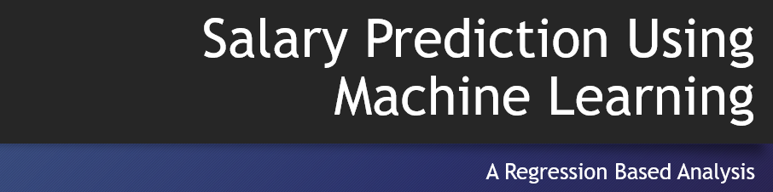
Salary Prediction Using Machine Learning
A Regression Based Analysis
NAME=SURYANSH KUMAR
STUDENT I.D= 231003003118

Slide 2

Introductions
This project builds a complete machine learning system that predicts employee salaries using multiple regression models. The dataset includes key features such as job title, years of experience, age, education level and other attributes that influence salary decisions.

Slide 3
Objective of the Project
The main goal is to analyze how different employee attributes contribute to salary prediction.
Another objective is to compare various regression algorithms and identify the best performing model.
The system is designed to run smoothly in Jupyter Notebook using Python and essential machine learning libraries.

Slide 4
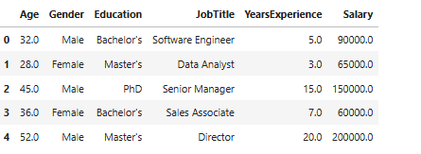
About the Dataset
The dataset used in this project contains 375 rows of employee information.
It includes columns such as age, gender, education, job title, years of experience and salary.

Slide 5
Data Preprocessing Steps
Missing values were removed to ensure accuracy.
Categorical features such as gender, education level and job title were converted into numerical format using one hot encoding.
The final dataset contained more than 170 feature columns after encoding.
Feature scaling was applied where needed for specific models.

Slide 6
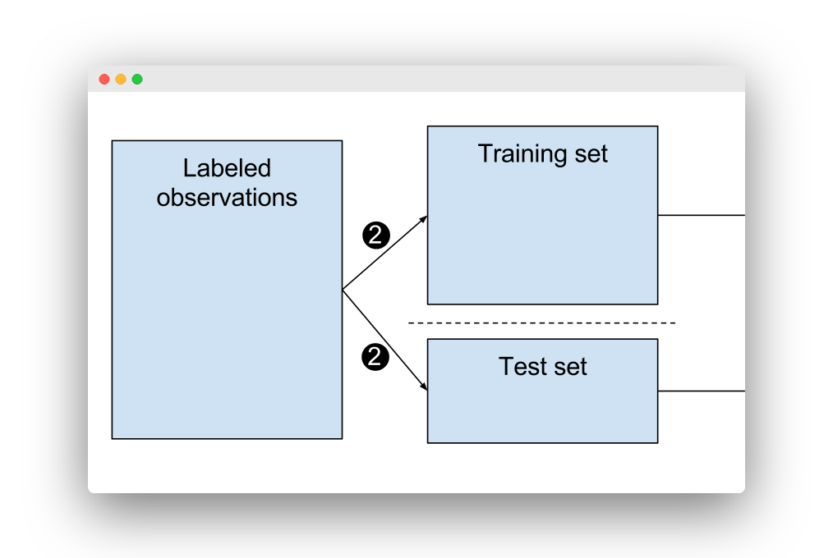
Train-Test Split
The dataset was divided into training and testing sets using an 80:20 split.
Training data was used to fit the machine learning models.
Testing data was used to evaluate performance and generate predictions.
This helps measure the real accuracy of each regression model.

Slide 7
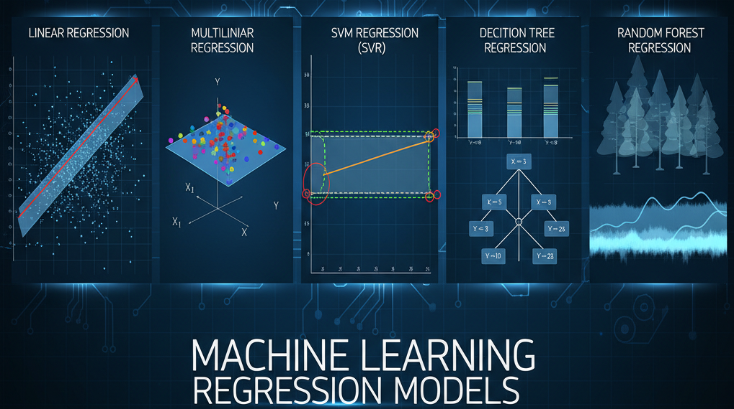
Regression Models Used
Simple Linear Regression to understand the relationship between salary and one variable.
Multiple Linear Regression using all encoded features.
Polynomial Regression to capture non-linear patterns in salary prediction.
Decision Tree Regression and Random Forest Regression to analyze patterns through tree-based approaches.
Support Vector Regression using the RBF kernel for smooth non-linear prediction.

Slide 8
Model Training and Prediction
All models were trained successfully on the processed dataset.
Each model generated predictions on the test set.
Models were compared based on accuracy and error values.
Python libraries numpy, pandas, matplotlib and sklearn were used throughout the project.

Slide 9
Evaluation Metrics
Two performance measures were used.
R2 Score which shows how well the model explains salary variations.
Mean Squared Error which measures how far predictions are from actual salaries.
Lower MSE and higher R2 Score indicate better model performance.

Slide 10
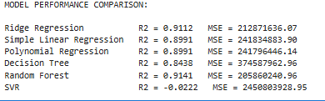
Comparison of Model Performance
Random Forest Regression achieved the highest accuracy with the best balance of R2 score and MSE.
Polynomial and simple linear regression also performed well with similar results.
Support Vector Regression performed moderately well.
Multiple Linear Regression gave extremely poor results due to the very high number of encoded features causing overfitting.

Slide 11
Conclusion
This project demonstrates how machine learning can be used to predict employee salaries using regression techniques.
Random Forest Regression proved to be the most reliable model for this dataset.
The system can be extended by adding more data, performing feature selection or optimizing hyperparameters.

Slide 12


